Slide 1
Computer Security
Communications, Networking & Security
Cryptography

Slide 2
Information is Power
“Information is Power”. Hence, gaining the ability to encrypt will help you maintain your edge on the competition.
OK, that’s a bold claim, and probably getting a bit ahead of oneself here. Yet, there exist many purposes to encrypt information: for security, safety, anonymity and privacy reasons, or simply for the fun of doing it. Sometimes there’s nothing like a good challenge, just for fun. With this mini-project we will create a simple encrypting tool to code a message, then provide a way to decrypt it. All of it is in Python, with code snippets and line by line walk-through.

Slide 3
Secure Communication
Needs and Requirements
Well established needs for secure communication
  War time communication
  Business transactions
  Illicit Love Affairs
Requirements of secure communication
  Secrecy
    Only intended receiver understands the message
  Authentication
    Sender and receiver need to confirm each others identity
  Message Integrity
    Ensure that their communication has not been altered, either maliciously or by accident during transmission

Slide 4
Cryptography
Basics
Cryptography is the science of secret, or hidden writing
It has two main Components:
  Encryption
    Practice of hiding messages so that they can not be read by anyone other than the intended recipient
  Authentication & Integrity
    Ensuring that users of data/resources are the persons they claim to be and that a message has not been surreptitiously altered

Slide 5


Encryption
Cipher
Cipher is a method for encrypting messages
Encryption algorithms are standardized & published
The key which is an input to the algorithm is secret
  Key is a string of numbers or characters
  If same key is used for encryption & decryption the algorithm is called symmetric
  If different keys are used for encryption & decryption the algorithm is called asymmetric
Plain Text
Encryption
Algorithm
Cipher Text
Decryption
Algorithm
Plain Text
Key A
Key B
Notes:
1. Must have done this as an assignment last year.

Slide 6
Encryption
Symmetric Algorithms
Algorithms in which the key for encryption and decryption are the same are Symmetric
  Example: Caesar Cipher
Types:
  Block Ciphers
    Encrypt data one block at a time (typically 64 bits, or 128 bits)
    Used for a single message
  Stream Ciphers
    Encrypt data one bit or one byte at a time
    Used if data is a constant stream of information

Slide 7
Symmetric Encryption
Key Strength
Strength of algorithm is determined by the size of the key
  The longer the key the more difficult it is to crack
Key length is expressed in bits
  Typical key sizes vary between 48 bits and 448 bits
Set of possible keys for a cipher is called key space
  For 40-bit key there are 2⁴⁰ possible keys
  For 128-bit key there are 2¹²⁸ possible keys
  Each additional bit added to the key length doubles the security
To crack the key the hacker has to use brute-force
  (i.e. try all the possible keys till a key that works is found)
  Super Computer can crack a 56-bit key in 24 hours
  It will take 2⁷² times longer to crack a 128-bit key
  (Longer than the age of the universe)
Notes:
1. Must have done this as an assignment last year.

Slide 8
Substitution Ciphers
Caesar Cipher
Caesar Cipher is a method in which each letter in the alphabet is rotated by three letters as shown
A B C D E F G H I J K L M N O P Q R S T U V W X Y Z
D E F G H I J K L M N O P Q R S T U V W X Y Z A B C
Let us try to encrypt the message
  Attack at Dawn
Assignment: Each student will exchange a secret message with his/her closest neighbor about some other person in the class and the neighbor will decipher it.

Slide 9
Substitution Ciphers
Caesar Cipher
Encryption
Plain Text
Message:
Attack at Dawn
Cipher:
Caesar Cipher
Algorithm
Cipher Text
Message:
Dwwdfn Dw Gdyq
Key (3)
Decryption
Cipher Text
Message:
Dwwdfn Dw Gdyq
Cipher:
Caesar Cipher
Algorithm
Plain Text
Message:
Attack at Dawn
Key (3)
How many different keys are possible?
Notes:
The key can be different -

Slide 10
Substitution Cipher
Monoalphabetic Cipher
Any letter can be substituted for any other letter
  Each letter has to have a unique substitute
There are 26! pairing of letters (~10²⁶)
Brute Force approach would be too time consuming
  Statistical Analysis would make it feasible to crack the key
A B C D E F G H I J K L M N O P Q R S T U V W X Y Z
M N B V C X Z A S D F G H J K L P O I U Y T R E W Q
Message:
Bob, I love you.
Alice
Cipher:
Monoalphabetic
Cipher
Encrypted
Message:
Nkn, s gktc wky.
mgsbc
Key
Notes:
Statistical Analysis
Knowing % of occurrences of different letters (e.g. e occurs 13% of time in the document and t occurs 19% of times)
Knowing commonly occurring two and three letter combinations (e.g. in, it, the, ion, ing, …)
If some knowledge about the content is available it is even easier to crack

Slide 11
Substitution Cipher
Polyalphabetic Caesar Cipher
Developed by Blaise de Vigenere
  Also called Vigenere cipher
Uses a sequence of monoalpabetic ciphers in tandem
  e.g. C₁, C₂, C₂, C₁, C₂
Example
Plain Text A B C D E F G H I J K L M N O P Q R S T U V W X Y Z
C1(k=6) F G H I J K L M N O P Q R S T U V W X Y Z A B C D E
C2(k=20) T U V W X Y Z A B C D E F G H I J K L M N O P Q R S
Message:
Bob, I love you.
Alice
Cipher:
Monoalphabetic
Cipher
Encrypted
Message:
Gnu, n etox dhz.
tenvj
Key
Notes:
Statistical Analysis
Knowing % of occurrences of different letters (e.g. e occurs 13% of time in the document and t occurs 19% of times)
Knowing commonly occurring two and three letter combinations (e.g. in, it, the, ion, ing, …)
If some knowledge about the content is available it is even easier to crack

Slide 12
Substitution Cipher
Using a key to shift alphabet
Obtain a key to for the algorithm and then shift the alphabets
  For instance if the key is word we will shift all the letters by four and remove the letters w, o, r, & d from the encryption
We have to ensure that the mapping is one-to-one
  no single letter in plain text can map to two different letters in cipher text
  no single letter in cipher text can map to two different letters in plain text
Plain Text A B C D E F G H I J K L M N O P Q R S T U V W X Y Z
C1(k=6) W O R D A B C E F G H I J K L M N P Q S T U V X Y Z
Message:
Bob, I love you.
Alice
Cipher:
Encrypted
Message:
??
WORD
Notes:
Statistical Analysis
Knowing % of occurrences of different letters (e.g. e occurs 13% of time in the document and t occurs 19% of times)
Knowing commonly occurring two and three letter combinations (e.g. in, it, the, ion, ing, …)
If some knowledge about the content is available it is even easier to crack

Slide 13
Transposition Cipher
Columnar Transposition
This involves rearrangement of characters on the plain text into columns
The following example shows how letters are transformed
  If the letters are not exact multiples of the transposition size there may be a few short letters in the last column which can be padded with an infrequent letter such as x or z
Plain Text
Cipher Text
T H I S I
S A M E S
S A G E T
O S H O W
H O W A C
O L U M N
A R T R A
N S P O S
I T I O N
W O R K S
T S S O H
O A N I W
H A A S O
L R S T O
I M G H W
U T P I R
S E E O A
M R O O K
I S T W C
N A S N S
Notes:
Statistical Analysis
Knowing % of occurrences of different letters (e.g. e occurs 13% of time in the document and t occurs 19% of times)
Knowing commonly occurring two and three letter combinations (e.g. in, it, the, ion, ing, …)
If some knowledge about the content is available it is even easier to crack

Slide 14
Ciphers
Shannon’s Characteristics of “Good” Ciphers
The amount of secrecy needed should determine the amount of labor appropriate for the encryption and decryption.
The set of keys and the enciphering algorithm should be free from complexity.
The implementation of the process should be as simple as possible.
Errors in ciphering should not propagate and cause corruption of further information in the message.
The size of the enciphered text should be no larger than the text of the original message.
Notes:
Statistical Analysis
Knowing % of occurrences of different letters (e.g. e occurs 13% of time in the document and t occurs 19% of times)
Knowing commonly occurring two and three letter combinations (e.g. in, it, the, ion, ing, …)
If some knowledge about the content is available it is even easier to crack

Slide 15
Encryption Systems
Properties of Trustworthy Systems
It is based on sound mathematics.
  Good cryptographic algorithms are are derived from solid principles.
It has been analyzed by competent experts and found to be sound.
  Since it is hard for the writer to envisage all possible attacks on the algorithm
It has stood the “test of time.”
  Over time people continue to review both mathematical foundations of an algorithm and the way it builds upon those foundations.
  The flaws in most algorithms are discovered soon after their release.
Notes:
Statistical Analysis
Knowing % of occurrences of different letters (e.g. e occurs 13% of time in the document and t occurs 19% of times)
Knowing commonly occurring two and three letter combinations (e.g. in, it, the, ion, ing, …)
If some knowledge about the content is available it is even easier to crack

Slide 16
Cryptanalysis
Techniques
Cryptanalysis is the process of breaking an encryption code
  Tedious and difficult process
Several techniques can be used to deduce the algorithm
  Attempt to recognize patterns in encrypted messages, to be able to break subsequent ones by applying a straightforward decryption algorithm
  Attempt to infer some meaning without even breaking the encryption, such as noticing an unusual frequency of communication or determining something by whether the communication was short or long
  Attempt to deduce the key, in order to break subsequent messages easily
  Attempt to find weaknesses in the implementation or environment of use of encryption
  Attempt to find general weaknesses in an encryption algorithm, without necessarily having intercepted any messages
Notes:
Statistical Analysis
Knowing % of occurrences of different letters (e.g. e occurs 13% of time in the document and t occurs 19% of times)
Knowing commonly occurring two and three letter combinations (e.g. in, it, the, ion, ing, …)
If some knowledge about the content is available it is even easier to crack

Slide 17
Data Encryption Standard (DES) Basics
Goal of DES is to completely scramble the data and key so that every bit of cipher text depends on every bit of data and ever bit of key
DES is a block Cipher Algorithm
  Encodes plaintext in 64 bit chunks
  One parity bit for each of the 8 bytes thus it reduces to 56 bits
It is the most used algorithm
  Standard approved by US National Bureau of Standards for Commercial and nonclassified US government use in 1993
Notes:
Statistical Analysis
Knowing % of occurrences of different letters (e.g. e occurs 13% of time in the document and t occurs 19% of times)
Knowing commonly occurring two and three letter combinations (e.g. in, it, the, ion, ing, …)
If some knowledge about the content is available it is even easier to crack

Slide 18
Data Encryption Standard (DES) Basics
64-bit input
56-bit key
48-bit k1
L1
R1
DES run in reverse to decrypt
Cracking DES
  1997: 140 days
  1999: 14 hours
TripleDES uses DES 3 times in tandem
  Output from 1 DES is input to next DES
F(L1, R1, K1)
48-bit k2
L2
R2
F(L2, R2, K2)
48-bit k3
L3
R3
F(L16, R16, K16)
48-bit k16
L17
R17
Notes:
DES consists of two permutations steps (the first and last steps of the algorithm)
Operation of each round is identical – taking output of the pervious round as input
During each round – the rightmost 32 bits of input are moved to left 32 bits of the output
The entire 64 bit input to the ith round and the 48-bit key for the ith round are taken as an input to a function
The function involves expansion of 4-bit chunks into 6-bit chunks , exclusive or-ing with the expanded 6-bit chunks of the 48-bit key Ki, a substitution operation and further exclusive OR-ing with the leftmost 32 bits of the input.
The resulting 32 bits of the input of the function is then used as the rightmost 32 bits of the round’s 64-bit output

Slide 19
Encryption Algorithm
Summary
Algorithm | Type | Key Size | Features
DES | Block Cipher | 56 bits | Most Common, Not strong enough
TripleDES | Block Cipher | 168 bits (112 effective) | Modification of DES, Adequate Security
Blowfish | Block Cipher | Variable (Up to 448 bits) | Excellent Security
AES | Block Cipher | Variable (128, 192, or 256 bits) | Replacement for DES, Excellent Security
RC4 | Stream Cipher | Variable (40 or 128 bits) | Fast Stream Cipher, Used in most SSL implementations
Notes:
Statistical Analysis
Knowing % of occurrences of different letters (e.g. e occurs 13% of time in the document and t occurs 19% of times)
Knowing commonly occurring two and three letter combinations (e.g. in, it, the, ion, ing, …)
If some knowledge about the content is available it is even easier to crack

Slide 20
Symmetric Encryption
Limitations
Any exposure to the secret key compromises secrecy of ciphertext
A key needs to be delivered to the recipient of the coded message for it to be deciphered
  Potential for eavesdropping attack during transmission of key
Notes:
1. Must have done this as an assignment last year.

Slide 21
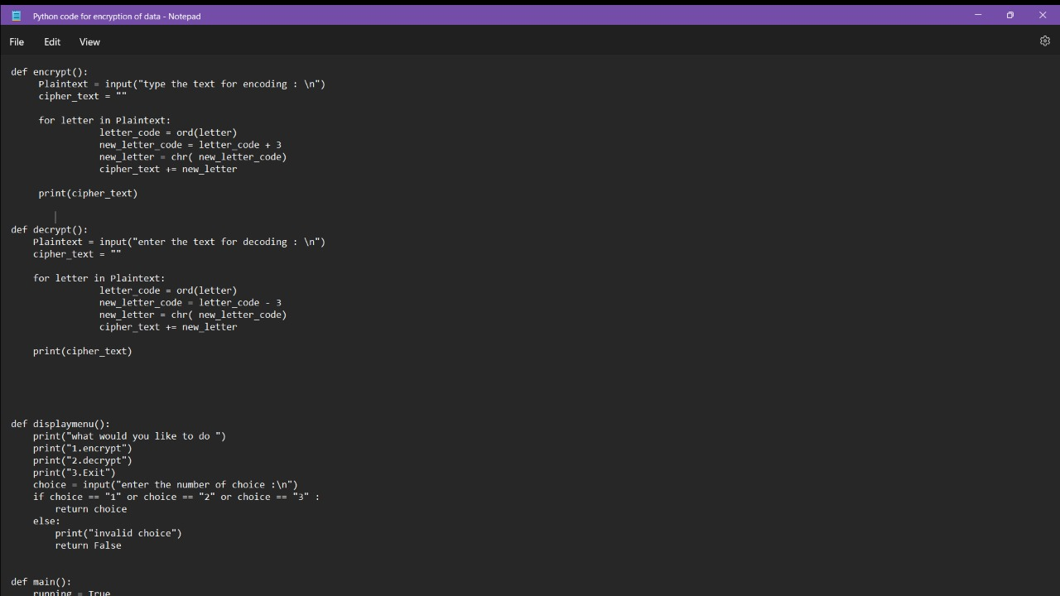
Input:
Notes:
1. Must have done this as an assignment last year.

Slide 22
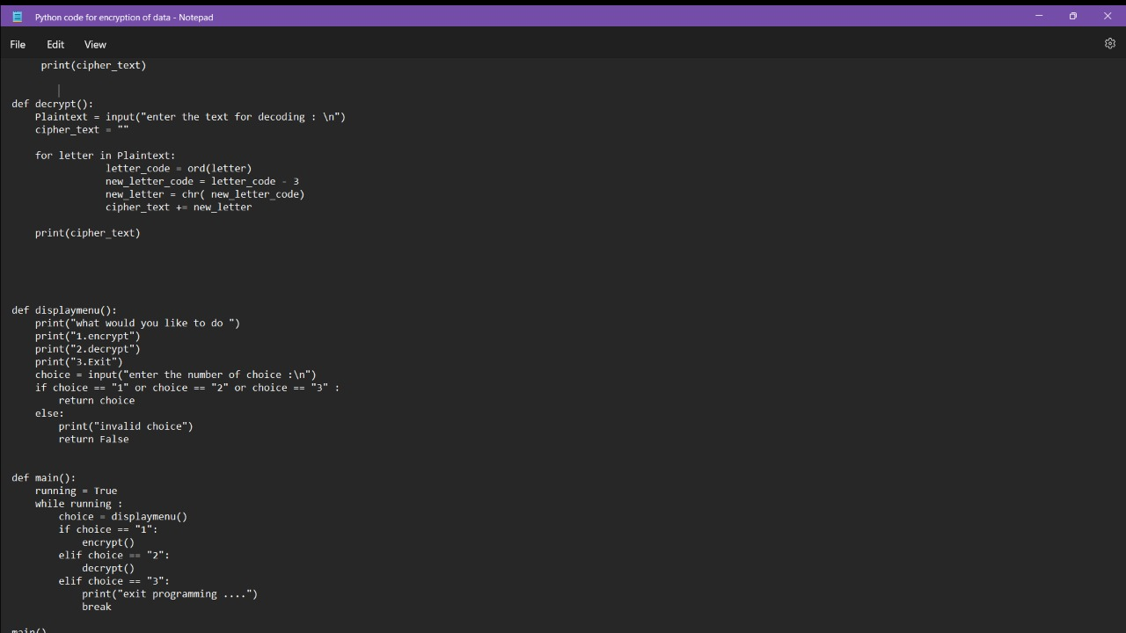
Notes:
1. Must have done this as an assignment last year.

Slide 23
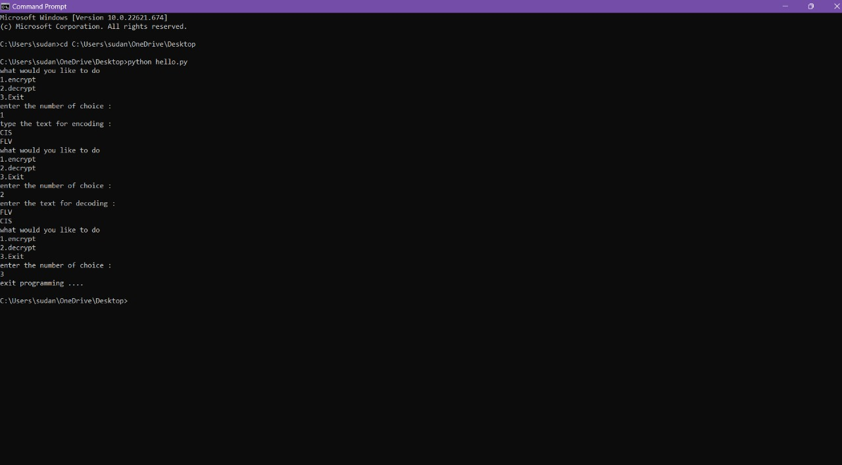
Output:
Notes:
1. Must have done this as an assignment last year.

